Slide 1


The Dynamic AI text analysis Platform
Presented by S M Yogeesh

Slide 2

TABLE OF CONTENTS
Project Overview
Dataset Overview and Key Insights
Methodology
Data Preprocessing
Feature Extraction
Model Architecture
Exploratory Data Analysis (EDA)
Visualization
Training and Evaluation
User Interface
Future Scope
Conclusion
Page No 1

Slide 3

PROJECT OVERVIEW
Objective: Analyze Twitter data to determine passenger sentiment toward US airlines.
Focus: Classify tweets as positive, neutral, or negative using ML and NLP.
Goal: Identify patterns in customer feedback for service improvement.
Approach: Combine text analytics, visualization, and model comparison.
Tools: Python, Scikit-learn, XGBoost, BERT, RoBERTa, TF-IDF, Matplotlib, Seaborn
Page No 2

Slide 4
DATASET OVERVIEW AND KEY INSIGHTS
Dataset: Twitter US Airline Sentiment (10,980 tweets, Feb 2015).
Airlines: United, Delta, American, Southwest, US Airways, Virgin America.
Sentiment split: Negative 63% (6,915 tweets), Neutral 16% (1,756 tweets), Positive 21%(2,309 tweets).
Frequent complaint areas: Flight delays, poor customer service, baggage loss.
Insight: Majority of tweets show dissatisfaction; Virgin America has highest positive feedback.
Page No 3

Slide 5
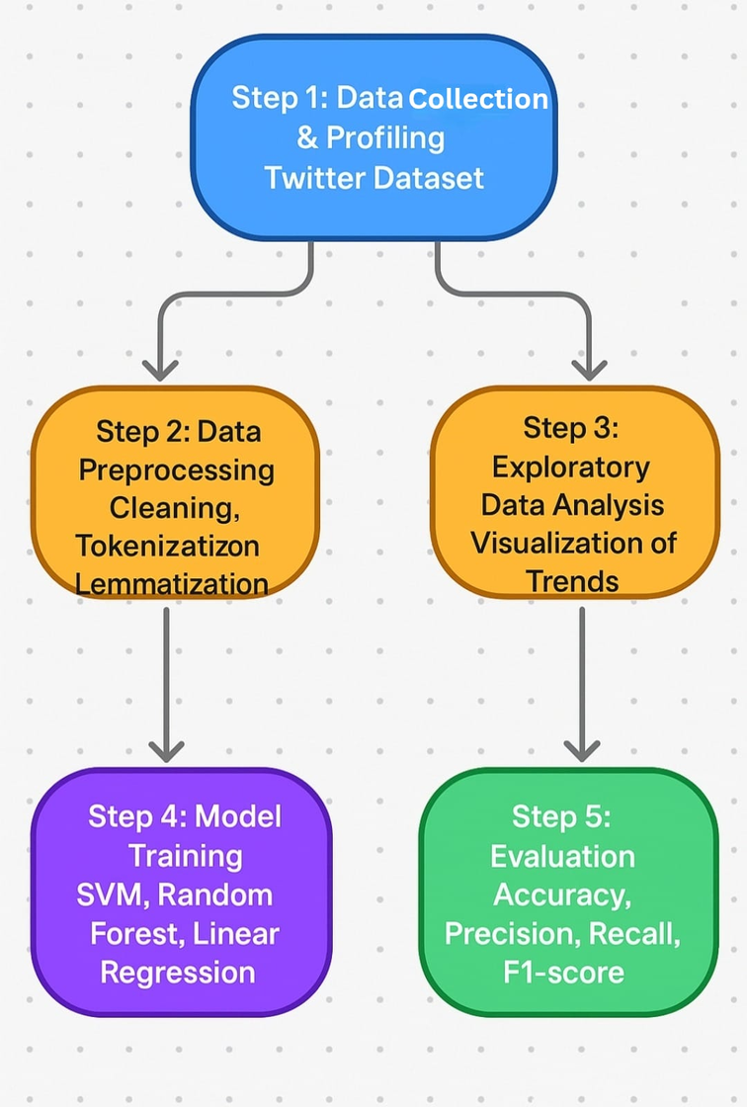
METHODOLOGY
Step 1: Data collection and profiling using the Twitter US Airline Sentiment dataset.
Step 2: Data preprocessing including cleaning, tokenization, lemmatization, and stop word removal.
Step 3: Exploratory Data Analysis (EDA) and visualization to identify sentiment patterns and trends.
Step 4: Model training using Machine Learning models (SVM, XGBoost) and Deep Learning models (BERT, RoBERTa).
Step 5: Model evaluation using performance metrics — Accuracy, Precision, Recall, and F1-Score.
Step 6: Results visualization through charts, graphs, dashboards, and word clouds for better interpretation.
Step 7: Summarization and reporting using extractive and abstractive techniques to generate final insights.
Page No 4

Slide 6
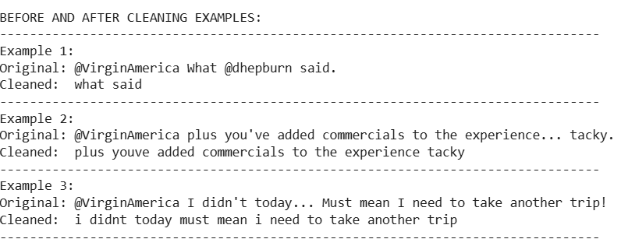
DATA PREPROCESSING
Removed unwanted elements: URLs, mentions, hashtags, emojis, RT markers.
Converted text to lowercase and normalized spacing.
Tokenized text into words and applied lemmatization.
Removed stop words to retain meaningful terms.
Result: 10,980 clean records with ~12 words per tweet and 5,000+ unique keywords.
Tweet Preprocessing Results: Original vs. Cleaned
Page No 5

Slide 7
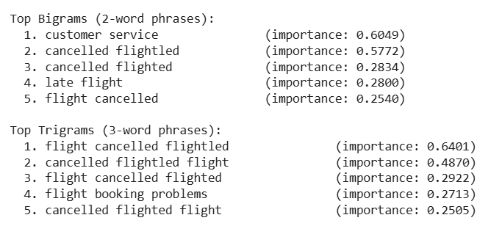
FEATURE EXTRACTION
Converted tweet text into numerical vectors using TF-IDF.
Applied text normalization before vectorization (lowercasing, stop word removal).
Used 10,000 max features with unigrams and bigrams (n-gram range: 1,2).
Set document frequency limits min: 3, max: 90% to remove rare and overly common terms.
Generated a sparse matrix (10,980 × 10,000) for efficient storage.
Extracted top keywords such as flight, delay, service, customer, great.
feature extraction summaries.
Page No 6

Slide 8
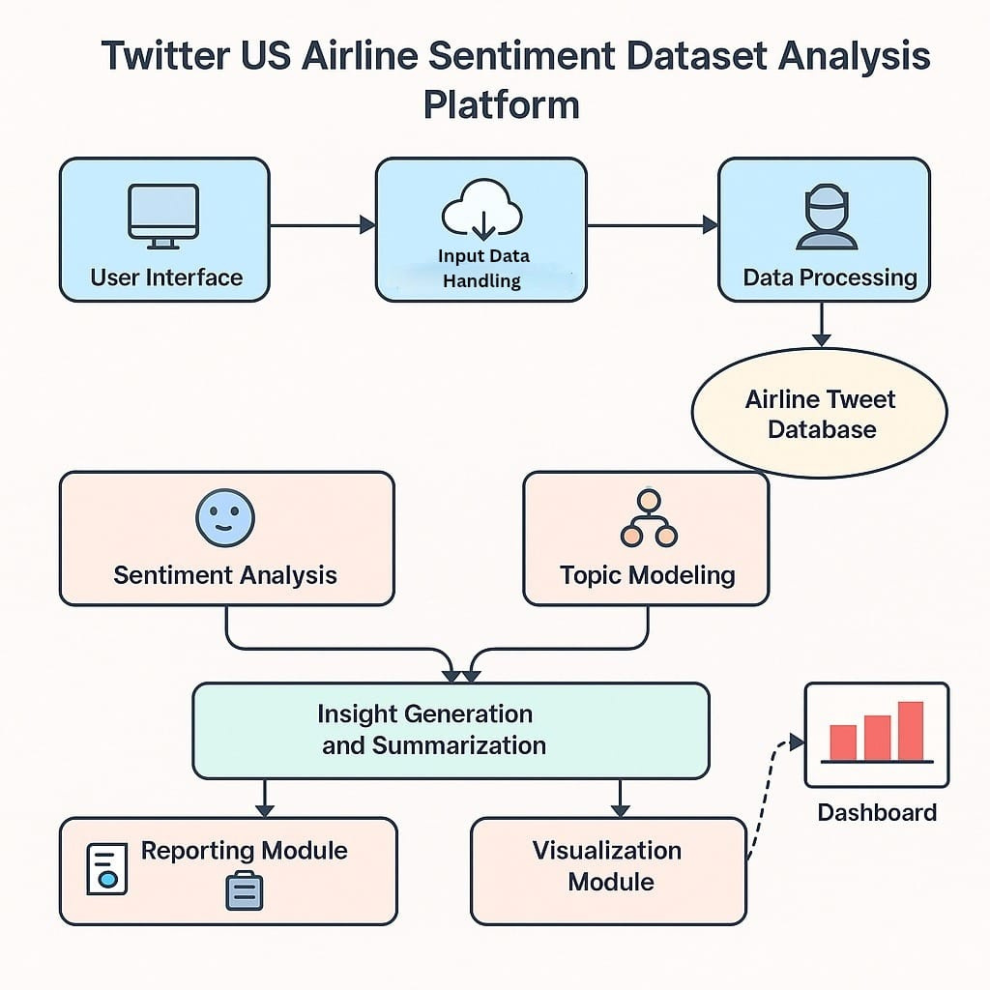
MODEL ARCHITECTURE.
Page No 7

Slide 9
EXPLORATORY DATA ANALYSIS (EDA)
Overall sentiment shows a strong negative bias — 63% negative, 21% positive, 16% neutral.
Most negative airlines: United (68%), US Airways (65%), American (64%); most positive: Virgin America (35%), Southwest (28%).
Negative tweets are longer, averaging 15–18 words, showing more detailed complaints.
Peak complaints occur during evening flight delays, weekdays, and weather disruptions.
Major negative themes: delays, poor service, baggage issues, and ticketing problems.
Positive feedback highlights friendly staff, punctuality, and smooth experiences.
Most complaints originate from major airports (NYC, LAX, ORD) with minimal regional variation.
Page No 8

Slide 10
VISUALIZATIONS
Static charts: Sentiment bars, pie charts, heatmaps, word clouds.
Interactive visuals (Plotly): Hover details, zoom, and filtering.
Key visuals:
Sentiment by airline (stacked bar).
Word frequency plots.
Correlation heatmaps.
Dashboard: Combined metrics on one page for clear insights.
Finding: Negative sentiment visually dominates; service quality is main issue.
Page No 9

Slide 11
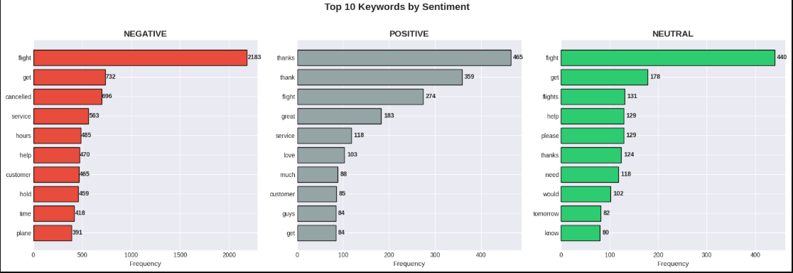
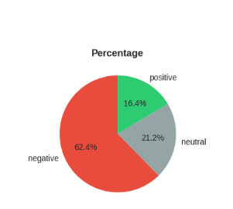
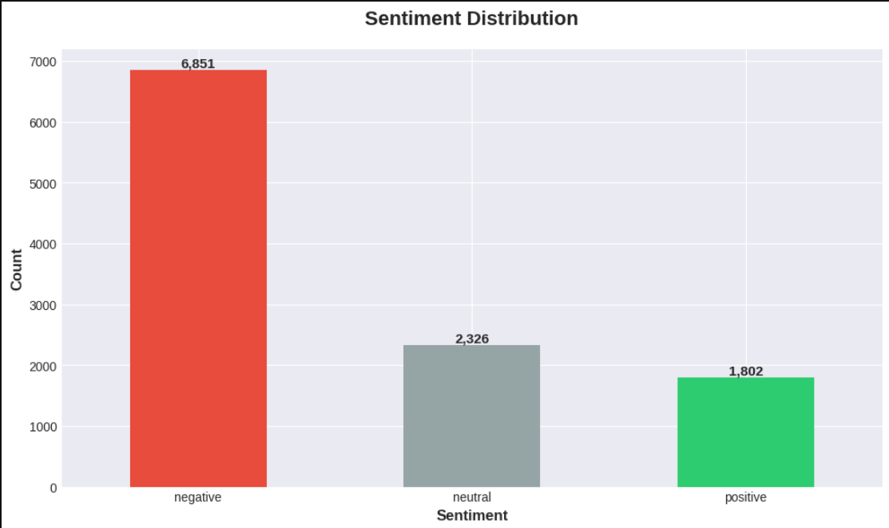
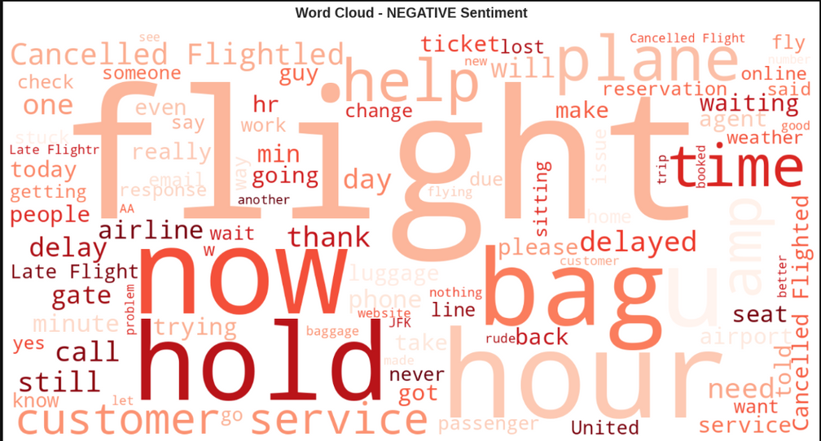
Page No 10

Slide 12
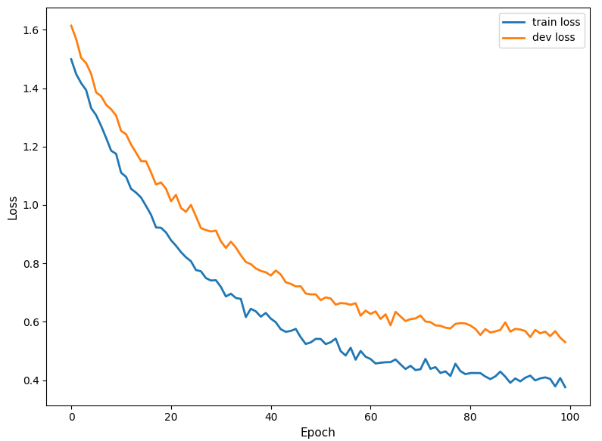
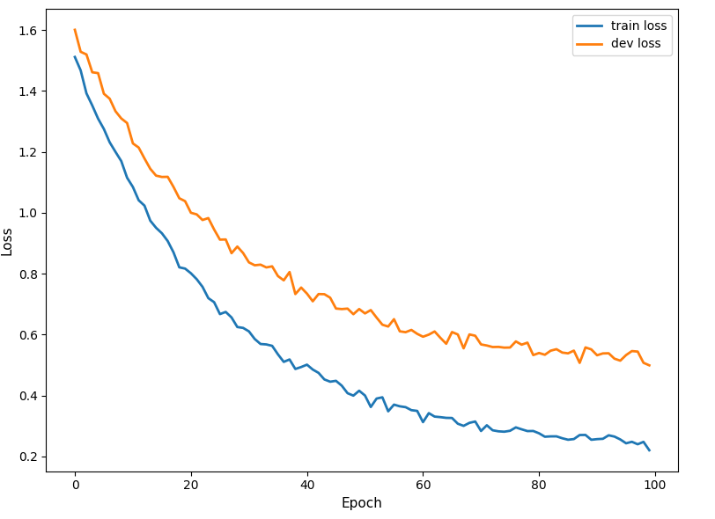
TRAINING AND EVALUATION
Data split: Train 70%, Validation 10%, Test 20% (stratified).
Applied 5-fold cross-validation and grid search for optimization.
Metrics: Accuracy, Precision, Recall, F1-Score, Loss curves.
Performance: SVM = 81.33%, Logistic Regression=79.05%,XGBoost=76.68%,
Random Forest=70.31%.
Fig 1. SVM
Fig 2.Logistic Regression
Page No 11

Slide 13
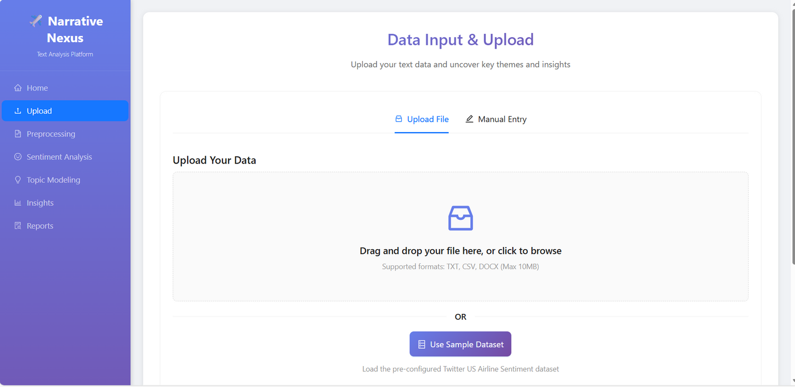
USER INTERFACE
Built interactive web dashboard (HTML, CSS, React , flask ).
Displays real-time statistics, airline-wise charts, and keyword summaries.
Includes 13 static and 4 interactive visuals.
Exports PDF, CSV, and text reports.
Page No 12

Slide 14

CHALLENGES
Data quality: Noisy, unstructured social-media text.
Class imbalance: Negative tweets dominate → bias risk.
Neutral detection: Ambiguous tone causes confusion.
Resource limits: Transformers need high GPU memory.
Solutions: Clean pipeline, class-weighted loss, DistilBERT, early stopping, balanced metrics.
Page No 13

Slide 15

CONCLUSION
Analyzed 10,980 tweets using Machine learning and Deep learning models.
Achieved 81.33%% accuracy with SVM .
Built complete visualization and reporting dashboard.
Extractive + Abstractive summarization captured key insights.
Outcome: Reliable sentiment analysis system for actionable airline insights.
Page No 14

Slide 16

Thank You

